Slide 1
Spacecraft Attitude Determination and Control
Brady Young
brady.young@lmco.com
November 8, 2012

Slide 2
What is ADCS?
[Attitude Determination and Control Subsystem]
“It’s all about orientation”
“Attitude” is the relative orientation of one frame to another
  With spacecraft, it always starts with a spacecraft-body-fixed frame relative to an inertially-fixed frame
  Anything “pointing” typically falls to the ADCS team to control
Acronym varies: ACDS, ACS, ADC,…
Fixed
to
S/C
Fixed
to
stars

Slide 3
Why ADCS is the Best Spacecraft Subsystem
Interconnected with all other subsystems
  Must point payloads at targets, COM antennas at ground stations, solar arrays at the sun…
Interesting work in all mission phases
  Mission design, S/C design, I&T, commissioning, operations, mission extensions
Nice balance of academic and production-oriented activities
  Analysis deeply rooted in theory, but hardware still has to fly!
Interpretive dance in the workplace

Slide 4
Part 1: Attitude Determination
“Where Am I?”

Slide 5
Describing an Attitude
Use your right hand!
There are many ways to represent an attitude:
  Euler angles (roll, pitch, yaw)
  Direction cosine matrices(“DCMs”)
  Quaternions
  Modified Rodriguez Parameters & others
Attitude is always relative! Always frame-A-to-frame-B.
Very common for attitudes to be nested:
A-to-C = A-to-B, then B-to-C
Z_{A}
Z_{B}
Y_{B}
Y_{A}
X_{A}
X_{B}

Slide 6
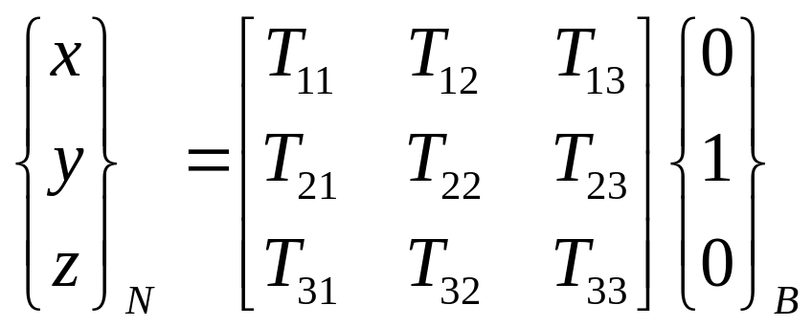
Describing Pointing
Usually comes down to a unit vector in a common frame
  Example: “The camera’s boresight is [x, y, z] in the ECI frame”
Assign convenient coordinate frames to instruments of interest
Then it’s just linear algebra to transform vectors from one frame to the next
Z_{N}
Z_{B}
Y_{B} =
[x, y, z]_{N}
Y_{N}
X_{N}
X_{B}
[T] is DCM describing a
transformation from B-to-N

Slide 7
AD in Theory
Comparing the landmarks seen by your sensors
against their known locations
Your Map:
Your Sensor Sees:
One vector isn’t enough information
Two vectors is too much information
“Triad” is the most simplistic reconciliation
  Decide which measured vector you trust more. Call it “vector_A”.
  Declare measured_vector_A = known_vector_A
  “Swivel” attitude about measured_vector_A until measured_vector_B is as close as it can be to known_vector_B

Slide 8
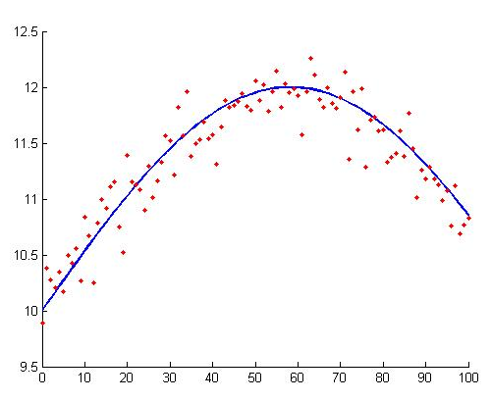
AD In Practice
We almost always collect more data than we need
Estimation: getting a small amount of quality information out of a large quantity of noisy measurements
Least Squares Fitting is used everywhere
Ex: Q-method, Kalman Filter

Slide 9
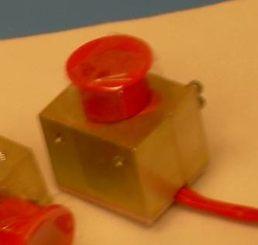
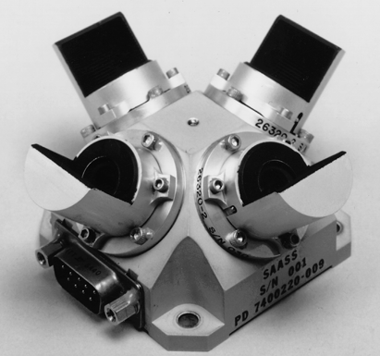
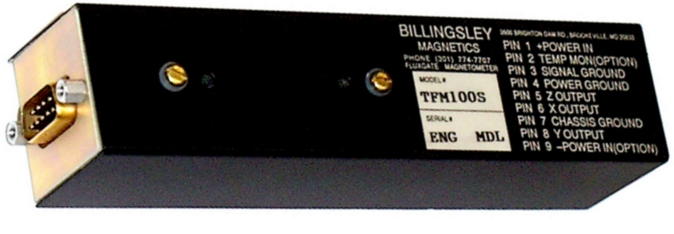
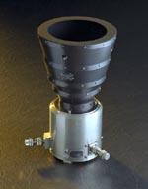
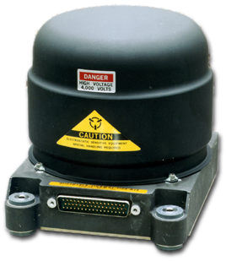
AD Hardware: Sensors
Earth Sensors / Horizon Sensors
  Optical instruments that scan for the CO₂ in Earth’s atmosphere
Sun Sensors
  When illuminated, report vector to sun
Magnetometer
  Detects Earth’s magnetic field as a 3D vector
Star Trackers / Star Cameras
  Takes pictures of the sky and maps stars against a catalog
Angular Rate Sensors
  Directly measure rate & direction of rotation vs. inertial space
  Iron gyros, Ring Laser Gyros, Fiber Optic Gyros
  “Relative” position measurements, suffer from drift over time

Slide 10
Part 2: Attitude Control
“Get a Move On!”

Slide 11
Common Attitude Targets
Orbit-fixed
Nadir Pointing
Inertial
Earth-target tracking
Spin about an axis (old school)

Slide 12
Most Generic Block Diagram
Automotive Example
The flight computer
and control law
The dynamics of the
actual, physical system
“Need to go 5 mph faster”
+
Error
Controller
Command
Plant
Target
“State”
“Open throttle 10 degrees!”
“I want to go 50 mph.”
-
“Now going 46 mph”
Sensor
Measurement
“The speedometer reads 45 mph”

Slide 13

Control Laws
The brains of the operation
PID control is by far the most common
    Proportional: based on displacement from target (like a spring)
      Good for responding quickly to disturbances
    Integrator: based on accumulated displacement from target
      Good for removing constant “DC” biases
    Derivative: based on rate of change (like a damper)
      Good for stability
  Frequency domain analysis techniques
    Bode plots, Nichols plots, …
Pointing, momentum management usually controlled independently

Slide 14
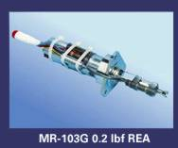
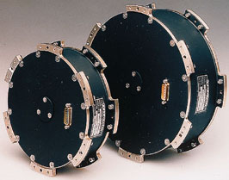

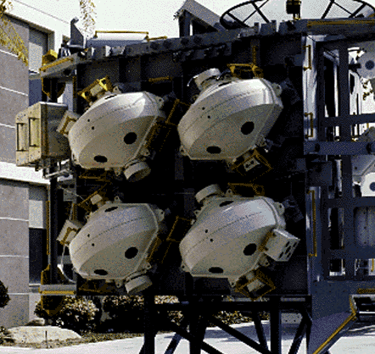
AC Hardware: Actuators
“A torque is a torque, no matter where it is located”
Thrusters
Electromagnetic Torque Rods
Reaction wheels
Control-Moment Gyros
Passive devices: gravity gradient boom, viscous dampers, aerobrakes

Slide 15
Backup

Slide 16
Speaking the Language
Open Loop Control: sending commands without real-time visibility into their effect
Closed Loop Control: commanding that adjusts in real-time based on its measured effectiveness
Gains – coefficients that dictate the responsiveness of the system
Phase Margin/Gain Margin: measures of stability
Bandwidth: what range of frequencies your system responds to
Propagation: predicting the state of the system sometime in the future based only on the current state of the system

Slide 17
“GNC”
Guidance
  “Figuring out where you are”
  The job of a sensor
  Example: “My speedometer says I’m going 25 mph, but I’d really like to be doing 50”
Navigation
  “Your strategy for getting where you want to go”
  The job of computers & algorithms
  Example: “I’ll cross into the left lane and pass this dump truck”
Control
  “Getting there”
  The job of actuators
  Example: mash pedal to the floor, turn wheel to the left, …

Slide 18
Orbits
Position and Velocity

Slide 19
Orbit Types
Low-Earth Orbit (LEO)
  Easy to get to, see lots of parts of the Earth
  Ex: Int’l Space Station, GEOEYE
Geosynchronous Orbit (GEO)
  See the same spot on the ground 24/7
  Ex: Satellite TV
Others:
  MEO, HEO
Space debris pic here

Slide 20
Defining Your Orbit
Keplarian Orbital Elements
You will always need 7 numbers to uniquely describe an orbit
One of them is always time… the “epoch”
Six orbital elements, or Position and Velocity as 3-element vectors
Semi-Major Axis (SMA)
Eccentricity
Inclination
Right Accention of Ascending Node
Argument of Perigee
True Anomaly
YOU ARE
HERE

Slide 21
Maneuvers
Hohman Transfer
  Most fuel efficient way to increase SMA (raise orbit)
  Burn in velocity direction at apogee
Higher orbits do fewer “revs” per day
  NOT intuitive for formation flying

Slide 22
Orbits: Speaking the Language
J2 – The equitorial “bulge” of the Earth
Spherical Harmonics – mathematical parameters to describe the shape of the Earth
Geoid – the gravitational shape of the Earth. The shape of the Earth if it were uniformly dense.
Precession – The slow rotation of the orbit plane about the Earth’s spin axis
  Caused by the J2. Rate of precession varies with altitude, inclination
Vernal Equinox – line formed by intersection of Earth’s equator and the plane of Earth’s orbit around the sun

Slide 23
Links
http://www.youtube.com/watch?v=dmnmuTv4pGE

